Slide 1
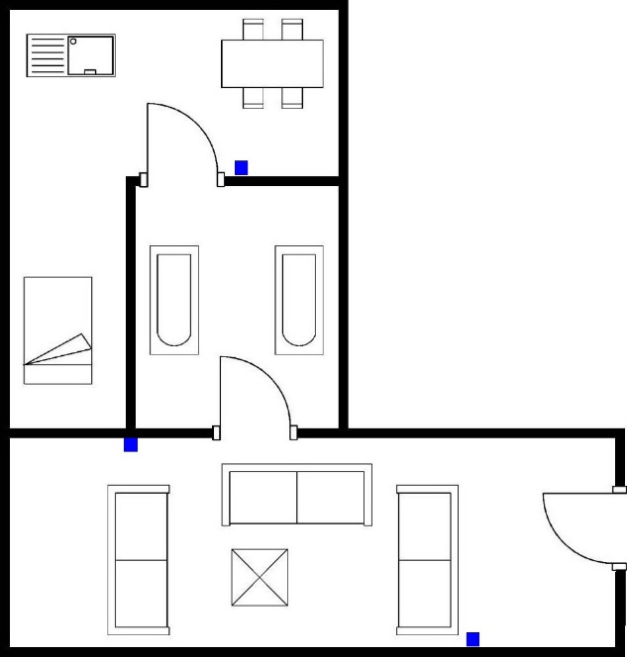
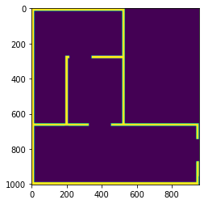
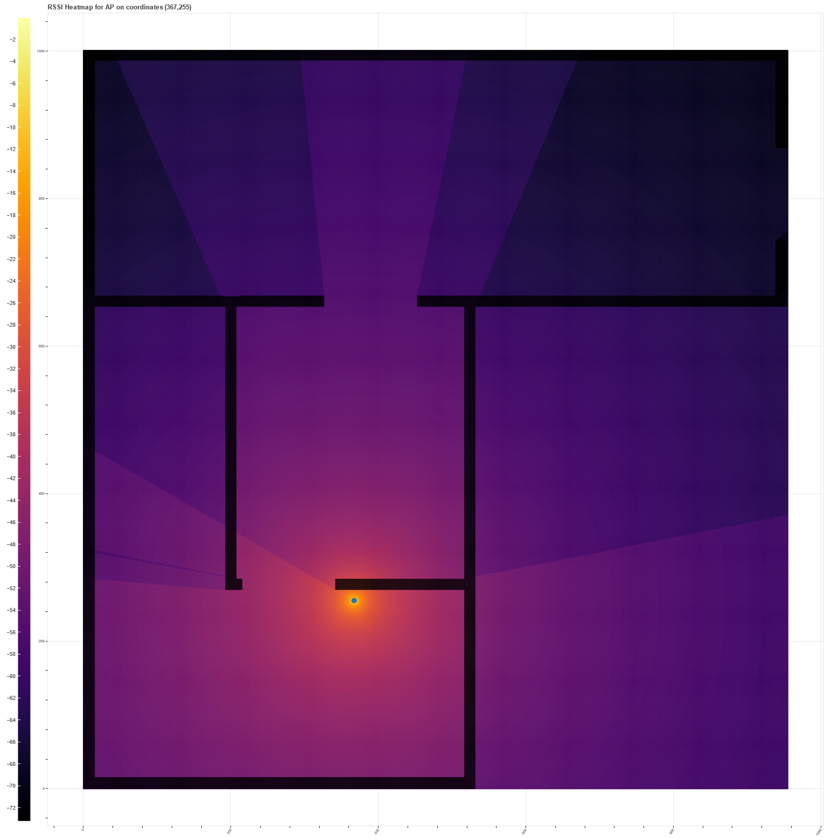
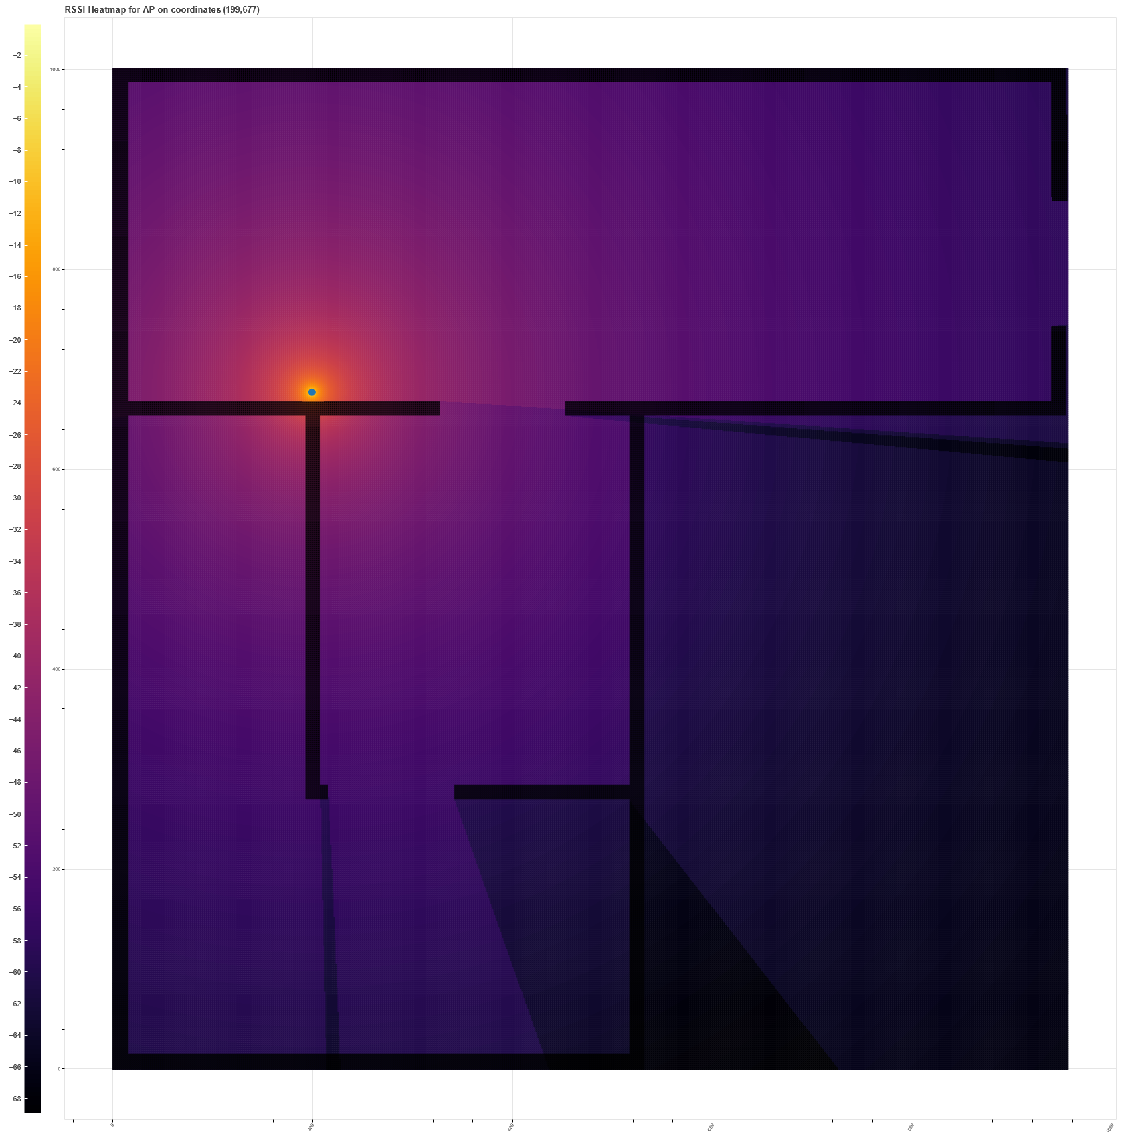


WiFi signals can be simulated to optimize coverage in a house
Optimization of WiFi Access Point placement in floorplans using signal propagation loss models in Python
INTRODUCTION
WiFi signal quality is of main importance in life recently
Poor Access Point placement can create areas of low coverage, or shadowing
Walls are the main signal attenuation factor in small residences
METHODS
Process house floorplan to eliminate small features
Identify walls with OpenCV
Calculate loss with Average Wall Model
Generate heatmap for all pixels
Repeat for all possible AP locations
Identify maximum average signal
Floorplan image with AP locations (blue)
Wall Identification
SIMULATION OUTPUTS
$$\begin{aligned}&L_{dB}=L_{0_{dB}}+20\log_{10}{d}+k_{w}L_{w}\end{aligned}$$
Henrique Silva
Shadowing in the living room
Good coverage in all rooms
Run the simulation!
https://linktr.ee/hsilvaou

